Slide 1


Investment Approach
31st August, 2026

Slide 2
Objective & Investment Philosophy
Focus on Return Optimization by investing in multicap portfolio of rising enterprises with sound corporate track record and sustainable business model keeping balance between value and growth strategy.
Objective
Value investing is the art of buying stocks which trade at a significant discount to their intrinsic value. Portfolio Manager achieve this by looking for companies on cheap valuation metrics, typically low multiples of their profits or assets, for reasons which are not justified over the longer term.
Growth investing is a style of investment strategy focused on capital appreciation. Portfolio Manager invest in companies that exhibit signs of above-average growth, even if the share price appears expensive in terms of metrics such as price-to-earnings or price-to-book ratios.
Value Growth

Slide 3
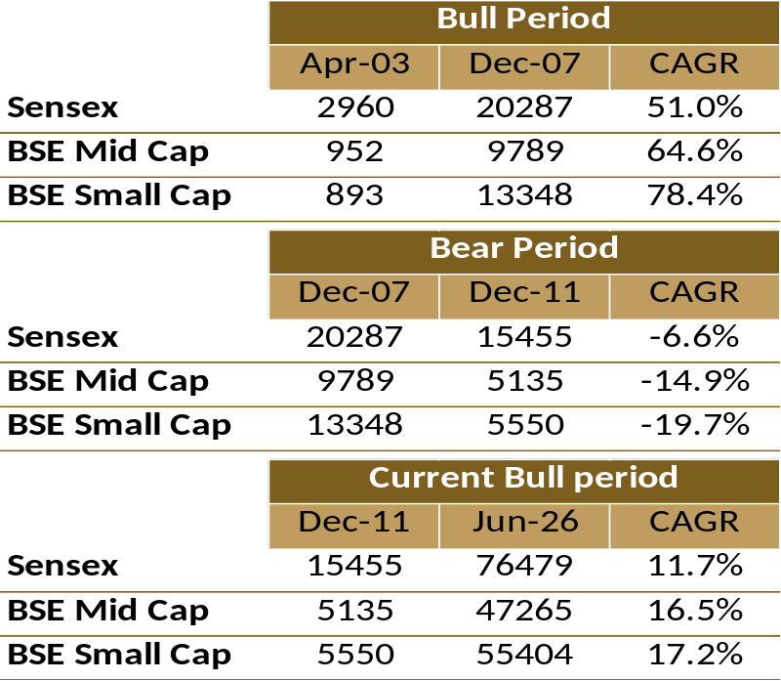
Why Multicap Strategy
The table shows outperformance of the Mid Cap and Small Cap Index over the Sensex Index during the Bull Period.
Outperformance of the Mid Cap and small caps happens because of better earnings growth in the bull phase.
The P/E for Mid cap and Small Caps also expands as earnings growth is superior v/s Sensex earnings growth.
Identifying the business within attractive valuation compare to their growth is key factor for outperformance.
Returns delivered from Mid Cap and Small Cap do outperform the Large Cap, however one should keep in mind the risk associated with it as we see the higher volatility in it. Therefore we emphasis on stringent stock selection strategy and create a diversified Multicap portfolio to create alpha over the benchmark.
Today’s Small Cap
Small Cap
are tomorrows
Mid cap
Mid Cap
Which may eventually become Large Cap
Large Cap
Maturity
Growth
Start Up

Slide 4
4P Strategy – Stock Selection
4P
Past Analysis
Business Moat /Market Share
Operating efficiency
Working Capital Management
Balance sheet growth
ROE And ROCE growth etc
Present Analysis
Current vs Historical
Valuation, Margins, leverage, Asset Turnover
Capacity and utilisation
Capex and Cashflow
Pedigree
Management Experience and Qualification
Corporate Governance Practices
Shareholding patterns
Potential
Sector Outook Favourable Macro
Sufficient capacity
Outstanding Order Book,
Multi year Contract, Client Addition,
Product Pipeline etc
Companies to undergo 4 P Analysis to make it to the Universe

Slide 5
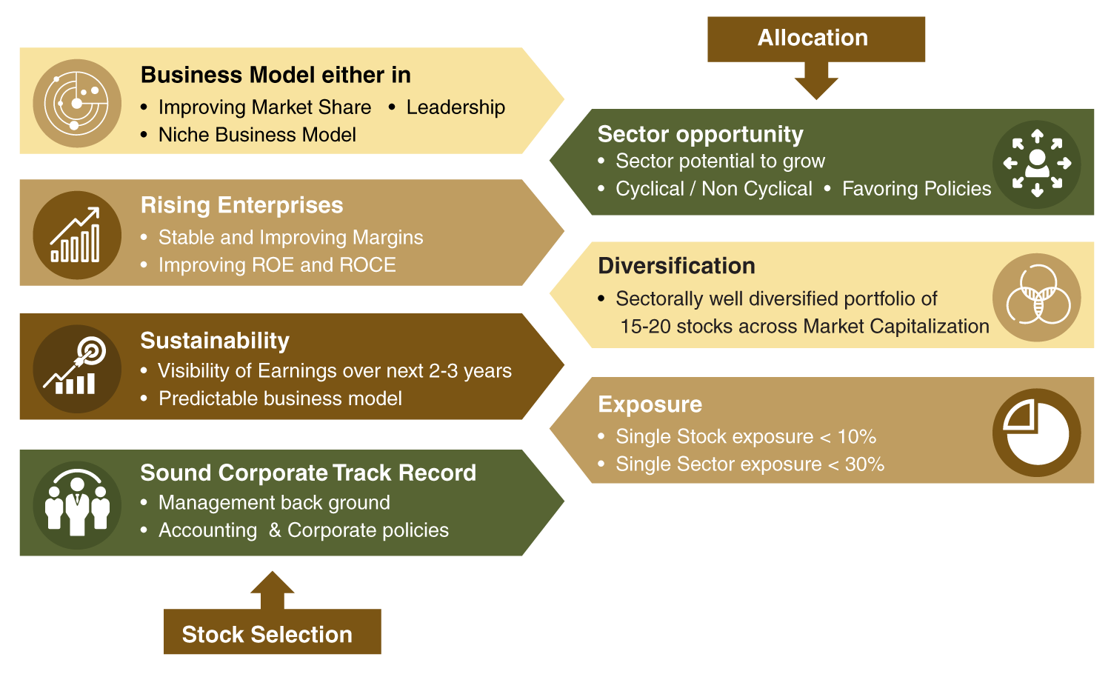
Investment Process

Slide 6
Re-VIEW Strategy
V
Valuation Check
A constant check is kept on the valuation of the companies so that any stock whose valuation becomes relatively high, due to any reasons like sentiments or increase in liquidity, is exited before any price correction comes to the stock. We then shift the money to a new stock with a reasonable valuation.
I
Impact of Events
A stock price can be highly affected by an event or series of events, recent examples: COVID crisis, Russia-Ukraine War, Increase in Crude Price, Interest Rates Hike etc. Our team actively tracks these events and makes timely modifications as per the situation’s needs to minimize risks & optimize returns.
E
Earnings Visibility Changes
Our fundamental research team scrutinizes the quarterly results of the companies to understand the current & future estimated growth. If we are not satisfied with 2 or 3 quarterly results of the company & don’t see growth, we take an exit to move to another stock.
W
Weightage Check of the Holdings
Every stock & sector has been capped to a certain percentage of the total allocation to limit downside due to any uncertainties and also diversify the portfolio. If any stock or sector reaches near to the decided percent of allocation, we book profits and reduce the weightage and invest into any other stock.

Slide 7
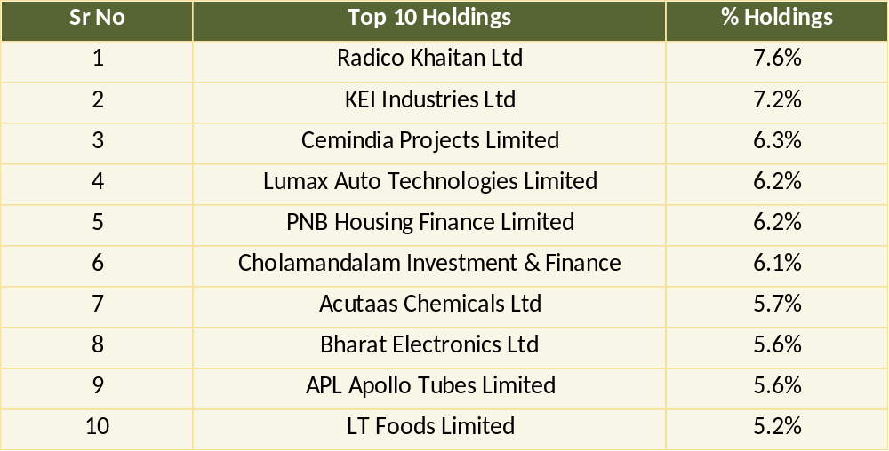
Top Holdings & Market Cap Allocation
The current model client portfolio comprise of 18 stocks. Portfolio is well diversified across market capitalization and sector. We have shown top 10 stocks based on current portfolio. Most of the stocks are given more or less equal and sizable weightage in portfolio.
Data as on 31st August 2026

Slide 8
Recent Portfolio Actions
Last 3 Investments (Buy) | Last 3 Exits (Sell)
Thermax Ltd | Titagarh Rail Systems Limited
Wockhardt Lt | PG Electroplast Limited
Acutaas Chemicals Ltd | KPI Green Energy Limited

Slide 9
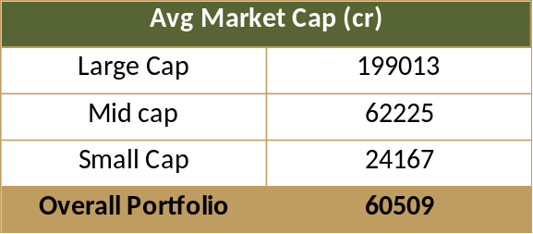
Portfolio Strategy
High
Portfolio Positioning
Medium to High
Risk & Reward
25%
Avg Est. EPS CAGR
35x
Fwd P/E FY28
IMPRESS Portfolio
Reward
Overall Portfolio Average Estimated* EPS expected to grow at 25% CAGR from FY26 to FY28
*Estimates Data as on 1st Sep 2026
Low
Risk
High
Focus on Quality Midcap and Small Cap.
No stock less then
2000 cr Market Cap
The portfolio is well balanced between the value and growth style of investment
Data as on 31st August 2026
Note: The above stocks are part of model client portfolio.
9
Source : Internal Research, Ace Equity, Bloomberg* (Estimates)

Slide 10
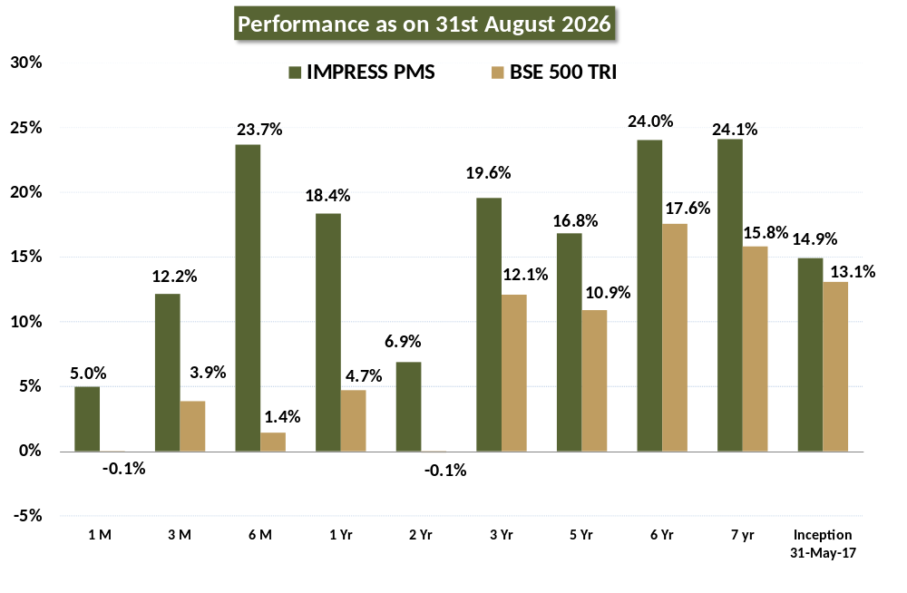
Portfolio Performance
Note: - Returns above one year are annualized. Returns net of fees and expenses.
Disclaimer: Past Performance is not necessarily indicative of likely future performance. Performance mentioned above are not verified by SEBI. We have shown the performance as Aggregate performance of all clients on TWRR basis.

Slide 11
Portfolio Performance
The table shows absolute portfolio returns (%) for investments made at the start of a given year and held until the end of each subsequent year.
Investment made From the start of
Returns | 2017 | 2018 | 2019 | 2020 | 2021 | 2022 | 2023 | 2024 | 2025 | 2026
2017 | 11.0%
2018 | -7.4% | -16.6%
2019 | -18.3% | -26.4% | -11.8%
2020 | 15.0% | 3.6% | 24.2% | 40.7%
2021 | 82.9% | 64.8% | 97.5% | 123.9% | 59.1%
2022 | 79.3% | 61.5% | 93.6% | 119.5% | 56.0% | -2.0%
2023 | 139.9% | 116.1% | 159.1% | 193.7% | 109.0% | 31.2% | 33.8%
2024 | 237.0% | 203.6% | 263.9% | 312.5% | 193.1% | 84.2% | 87.9% | 40.5%
2025 | 203.9% | 173.8% | 228.2% | 272.0% | 164.4% | 66.2% | 69.5% | 26.7% | -9.8%
2026 YTD | 262.4% | 226.5% | 291.4% | 343.6% | 215.3% | 98.1% | 102.1% | 51.1% | 7.6% | 19.3%
How to read this table:
Columns represent the year in which an investor started investing.
Rows represent the year up to which the investment is held.
Each cell shows the absolute return (%) earned by an investor who invested at the start of the column year and stayed invested until the end of the row year.
Green cells indicate positive returns, while red cells indicate periods of drawdown.
Till the end of
Note: - The Returns mentioned above are absolute returns. Returns net of fees and expenses.
Disclaimer: Past Performance is not necessarily indicative of likely future performance. Performance mentioned above are not verified by SEBI. We have shown the performance as Aggregate performance of all clients on TWRR basis.

Slide 12
3 Year Rolling Returns
Metric | Since Inception | Since July 2018
Total Observations Days | 2285 | 1888
Total Positive Days | 2150 | 1888
Positive Returns Observation % | 94% | 100%
Total Outperformance Days | 1887 | 1887
Observation Beating the Benchmark % | 82% | 100%
Average 3 Year Rolling Returns | 20.4% | 24.2%
Average Outperformance P.A. | 4.0% | 5.9%
Standard Deviation | 9.7% | 5.0%
Data as on 31st August 2026
Note:
The Returns net of fees and expenses.
Disclaimer:
Past Performance is not necessarily indicative of likely future performance. Performance mentioned above are not verified by SEBI. We have shown the performance as Aggregate performance of all clients on TWRR basis.

Slide 13
Key Ratios
Particulars | Current |  |  | Ratios (5 Years Data)
 | P/E | P/B | PEG | BETA | Standard Deviation | Sharpe Ratio | Treynor Ratio | Jenson Alpha | Avg. Portfolio Turnover
IMPRESS PMS | 52x | 9.49 | 1.7 | 1.15 | 20.8 | 0.87 | 15.8 | 5.02 | 38%
BSE 500 TRI | 24x | 4.46 | 1.6 | 1 | 14.3 | 0.80 | 11.4 | NA | NA
P/E | Measures how much investors pay for every ₹1 of a company’s earnings. Lower P/E may indicate cheaper valuation, while higher P/E reflects higher growth expectations.
P/B | Measures the price investors pay for every ₹1 of a company’s book value. Lower P/B may indicate relatively cheaper valuation.
PEG | Compares a company’s P/E with its expected earnings growth. Lower PEG generally indicates a more attractive valuation relative to growth.
Beta | It measures how much an investment moves compared to the overall market. Beta of 1 means it moves with the market, less than 1 means less risk and greater than 1 means more risk.
Standard Deviation | Shows how much the returns of an investment can go up or down. High ratio means the returns can be very different from the average, making it riskier, while a low standard deviation means the returns are more stable and predictable.
Sharpe Ratio | It tells us how much return we get for the risk we take with an investment. A higher Sharpe ratio means better returns for each unit of risk, making it a good measure of how well an investment compensates for its risk.
Portfolio Turnover | Also called as churn ratio, is used to reflect the frequency of transactions done in the portfolio. High turnover means high frequency of trading, while low turnover means the investments are mostly held for longer periods.
Treynor | It shows how much return an investment gives for the risk taken from market movements. A higher Treynor ratio means better performance for the given risk.
Jenson Alpha | It is used to determine if a portfolio is earning proper returns for the level of its risk. Positive value means that the fund manager is outperforming the market with their stock-picking skills.
Note: PEG taken for FY27

Slide 14
Success Stories – Radico Khaitan
Radico Khaitan Limited (RKL) is one of the oldest and the largest manufacturers of Indian Made Foreign Liquor (IMFL) in India.
RKL is one of the few companies in India to have developed its entire brand portfolio organically, with in-house capabilities.
With over 15 brands including four millionaire brands in its portfolio – 8PM Whisky, Magic Moments Vodka, Contessa XXX Rum and Old Admiral Brandy - the rich history of over 75 years continues to set the pace for today and shape the business outlook for tomorrow.
Through premium brand launches, backward integration, better pricing and wider distribution, Radico Khaitan is in a sweet spot.

Slide 15
Success Stories – KEI Industries
KEI Industries is a leading manufacturer of electrical wires & cables.
Energy transition (solar and wind), expansion in transmission and distribution networks, and healthy activity across data centers, real estate, and broader infrastructure segments are supportive for the growth.

Slide 16
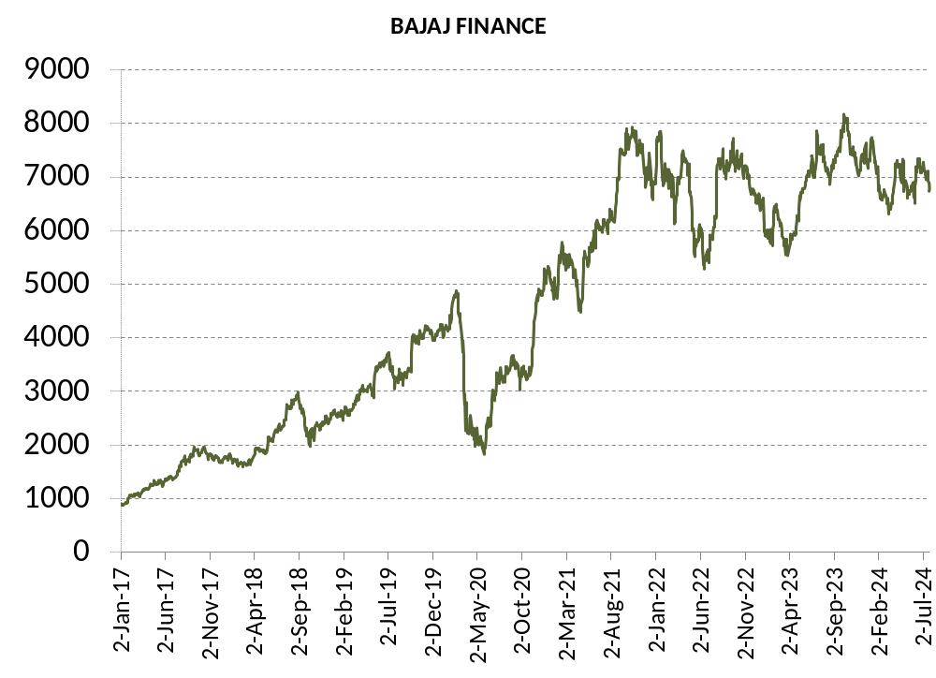
Success Stories - Bajaj Finance
Bajaj Finance
One of the Fastest growing and well diversified NBFC from the Bajaj Group.
Consistent growth in NII and ROA with NPA under control.
Focus on retail franchise.
Always got better valuation then peers.
Exited full investment as credit growth is lilkely to be slower and with base reaching so high for NBFC and Capital raising to dilute earning. Which will pull down the premium valuation it command due to high growth.
Partial Profit
Book
Full Profit
Book
Full Profit
Book
Added Back
Partial Profit
Book
Initial buy
Added Back

Slide 17
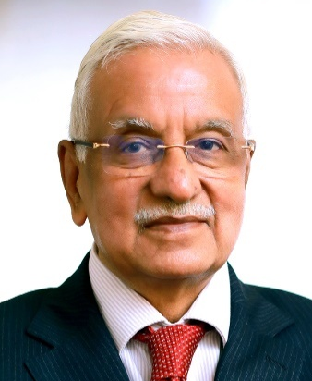
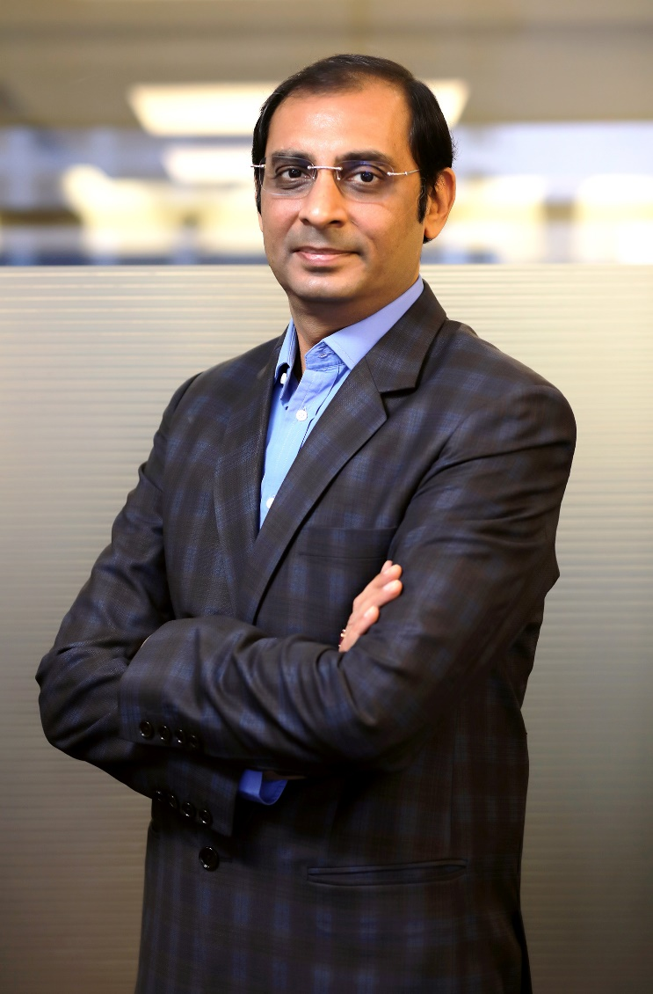
Founder & Promoter (Anand Rathi Group)
Gold medalist Chartered Accountant having more than four decades of rich and varied experience in corporate management, financial & capital markets and corporate & management consultancy.
Served Aditya Birla Group at very senior positions for more than 25 years before starting his own financial services outfit. Shri Rathi was earlier President of BSE for two terms.
Anand Rathi Group derives its strength and vision from legendary leadership of Shri Anand Rathi and charting growth path in his able guidance.
Anand Rathi
Founder & Chairman
Over twenty years broad based experience in the securities market and key driver of the Retail and Institutional Equities business of the group.
Under his leadership, the Group’s Institutional & Retail Business has won great recognition and many accolades. He has played a pivotal role in the Group’s network expansion and pan India growth.
His valuable contribution towards professionalizing the management of the Group has won him immense respect from the corporate world.
Pradeep Gupta
Co Founder &
Vice Chairman

Slide 18
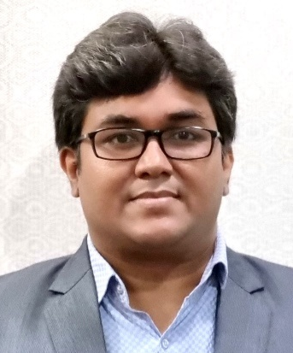
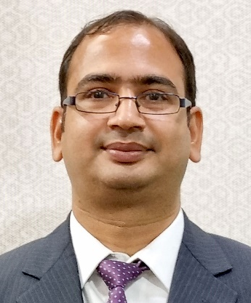
Fund Management Team
More than 21 years of rich experience in Investment advisory, Product Development and Portfolio Management.
Working with Anand Rathi since 2007 across Portfolio Management and Private Client Group Equity Advisory.
Started Career with “Kotak Securities Ltd” in 2005 as an Investment Advisor subsequently got into developing Equity products and running the same.
Qualified MBA (Finance) from Mumbai University and Certified Financial Planner.
Mayur Shah
Fund Manager
More than 22 years of rich experience in Investment advisory, Portfolio Management and research.
Worked in past with Standard Chartered Securities, Religare Securities, Enam Securities.
PGDBM from Mumbai.
Vinod Vaya

Slide 19
Features
IMPRESS Portfolio
Minimum investment
Strategy
Allocation
Investment Approach
Risk - Reward & Tenure
Type of instruments
Benchmark
Rs. 50 lakhs.
EQUITY
15-20 STOCKS, diversified across sectors. Multicap – Spread between Small, Mid and Large Cap
Multicap Portfolio - Balanced between Value and Growth. Most of the companies have adequate analyst coverage. Most of the stocks will be part of core portfolio.
Medium to High Risk. Investment tenure 3 year plus
Equity & Equity Related Instruments, Fixed Income Instruments, Cash & Cash Equivalent
BSE 500 TRI
Fees & Charges
Benefits
Dedicated Web Login for client to monitor portfolio.
A relationship manager to cater to investment needs
Constant monitoring of the portfolio
Audited statement at year end for tax filing purpose.
Support
Back office customer service desk to address client queries
AMC fees : 2.5% p.a (Charged Pro-rata at end of each quarter)
Brokerage : 0.10% on Equity delivery transaction
Exit Load : 2% - 1st Year, 1% - 2nd Year, NIL after 2nd Year.
Other Charges : GST, Other charges levied by Exchange, Custodial charges (3 bps) levied by custodian and any other statutory charges.

Slide 20
Specific Disclaimer
All Investment are subject to Market Risk.
Please read the risk factors before investing in the same.
Past Performance is not necessarily indicative of likely future performance
Registration Details
Direct On-Boarding
PMS registered under : Anand Rathi Advisors Ltd.
PMS Registration Number : INP000000282.
Custodian : Orbis Financial Corporation Ltd.
To invest directly into our PMS, please:
Mail: pmsdesk@rathi.com
Contact: 022-62813851, 52
Or click here: https://www.anandrathipms.com/contact-us.php
Product Support
Back Office Support
More Information
Name : Vinod Vaya
Tel : 022 - 6281 3851
Email ID : vinodvaya@rathi.com
Name : Namita Thakur / Mitali
Tel : 022 – 6281 1577
Email ID : pmsdesk@rathi.com
Visit Our Website: https://www.anandrathipms.com
Click here for Disclosure Document
OFFICIAL ADDRESS: 10th Floor, Express Zone - A Wing, Western Express Highway, Malad (East),
Mumbai - 400063, India
BOARD LINE : +91 22 6281 7000

Slide 21



THANK YOU
Disclaimer:-This presentation has been issued by Anand Rathi Advisors Limited (ARAL), which is regulated by SEBI. Neither the information nor any opinion expressed constitutes an offer, or an invitation to make an offer, to buy or sell any securities or any options, futures or other derivatives related to such securities ("related investments"). ARAL and its affiliates may trade for their own accounts as market maker / jobber and/or arbitrageur in any securities of this issuer(s) or in related investments, and may be on the opposite side of public orders. ARAL, its affiliates, directors, officers, and employees may have a long or short position in any securities of this issuer(s) or in related investments. ARAL or its affiliates may from time to time perform investment banking or other services for, or solicit investment banking or other business from, any entity mentioned in this report. This presentation is prepared for private circulation. It does not have regard to the specific investment objectives, financial situation and the particular needs of any specific person who may receive this report. Investors should seek financial advice regarding the appropriateness of investing in any securities or investment strategies discussed or recommended in this report and should understand that statements regarding future prospects may not be realized. Investors should note that income from such securities, if any, may fluctuate and that each security's price or value may rise or fall. Past performance is not necessarily a guide to future performance. Foreign currency rates of exchange may adversely affect the value, price or income of any security or related investment mentioned in this report.

