Slide 1


Portfolio Management Services
PMS – Investment Approach
August, 2026

Slide 2
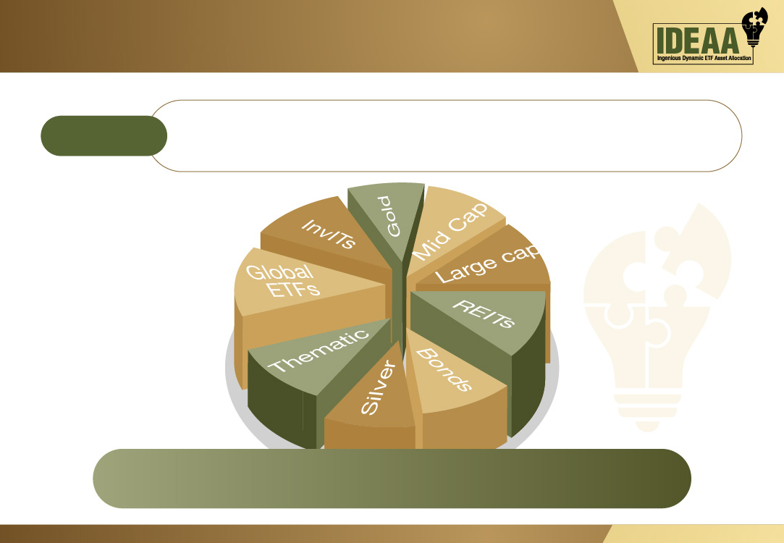
Objective
Objective
Focus on consistency of return with risk moderation by Dynamically allocating investments in multiple asset class through ETF based on market conditions.
Investments will be made into multiple ETFs listed on NSE and BSE of different asset class like Equity, Debt, Commodities and REITS and InVITS.

Slide 3

Why Dynamic Multi Asset Investment
Most HNI and Ultra HNI clients do their own investment asset allocation into various asset classes at personal level.
Different Asset classes performs in different time interval, to capture the diverge nature of underlying asset price movement a professionally manage multi asset fund can smoothen out the returns at overall portfolio level.
For better alpha creation Professionals with strong research on broader market can dynamically manage portfolio with switch in and out from various asset class depending upon broader market outlook.
It tries to reduce the volatility at portfolio level with diversification in less correlated asset classes and provide better risk adjusted returns.

Slide 4

Why Dynamic Multi Asset Investment
Reduced Risk
By spreading investments across various sectors and asset classes, ETFs help reduce the risk associated with individual securities.
Diversification
ETFs allow you to invest in a wide range of assets, including stocks, bonds, commodities, and real estate, providing broad market exposure.
Liquidity
ETFs are traded on stock exchanges like individual stocks, allowing you to buy and sell them throughout the trading day at market prices. This liquidity gives quick access to the funds when required
Low Costs
ETFs typically have lower expense ratios compared to mutual funds, making them a cost-effective investment option
Flexibility
There are ETFs for almost every asset class, sector, and investment style, providing flexibility in constructing a tailored portfolio. The variety of ETFs can help structure the portfolio as per the requirements or market conditions. (Growth - income)

Slide 5

Why Dynamic Multi Asset Investment
As no single asset class consistently outperforms every year, diversification is key.
Spreading investments across Domestic Equity, Global Equity, Gold and Debt helps balance risk and capture opportunities in different market phases.
Calendar Year | Domestic Equity | Global Equity | Gold | Debt | Best Performer | Worst Performer
2012 | 31.84% | 13.41% | 11.22% | 10.83% | Domestic Equity | Debt
2013 | 3.61% | 29.60% | -6.39% | -0.79% | Global Equity | Gold
2014 | 37.82% | 11.39% | -9.32% | 14.59% | Domestic Equity | Gold
2015 | -0.72% | -0.73% | -7.50% | 7.26% | Debt | Gold
2016 | 3.84% | 9.54% | 12.52% | 15.03% | Debt | Domestic Equity
2017 | 35.91% | 19.42% | 2.43% | 0.34% | Domestic Equity | Debt
2018 | -3.38% | -6.24% | 6.67% | 6.11% | Gold | Global Equity
2019 | 7.66% | 28.88% | 22.95% | 9.41% | Global Equity | Domestic Equity
2020 | 16.67% | 16.26% | 27.00% | 8.75% | Gold | Debt
2021 | 30.19% | 26.89% | -5.19% | 1.33% | Domestic Equity | Gold
2022 | 3.02% | -19.44% | 12.80% | 0.40% | Gold | Global Equity
2023 | 25.76% | 24.23% | 14.68% | 8.08% | Domestic Equity | Debt
2024 | 15.16% | 23.31% | 19.44% | 9.55% | Global Equity | Debt
2025 | 6.69% | 16.39% | 66.36% | 6.85% | Gold | Domestic Equity
2026 | -3.67% | 9.55% | 5.32% | 2.21% | Global Equity | Domestic Equity
Note: Domestic Equity, Global Equity, Gold & Debt are Nifty 500, S&P 500, Gold & India 10Y G-Sec Respectively

Slide 6
Why Dynamic Multi Asset Investment
Multi-Asset Strategy:
Evidence of Resilience in Declining Markets (Refer Chart below)
Lower Drawdown vs Peers: Nifty Multi Asset fell only -16.46%, significantly less than Nifty 500 (-29.98%) and S&P 500 (-24.77%), indicating better downside protection.
Natural Hedge through Diversification: By combining equity, debt (like G-Secs), and commodities (like Gold), the strategy smoothens volatility, even when individual assets drop steeply.
Superior Risk-Adjusted Performance: While Gold and S&P 500 dropped more than -24%, the multi-asset approach outperformed both by smart allocation.
Defensive During Market Turmoil: Multi Asset strategies help investors stay invested through tough times with less portfolio erosion, ensuring better compounding over the long term.
Max Drawdown
NIFTY MULTI ASSET | -16.46%
GOLD | -24.38%
G-Sec Bond | -7.79%
S&P 500 | -24.77%
NIFTY 500 | -29.98%
Note: Data from 1st April 2010 to 30th June 2026

Slide 7

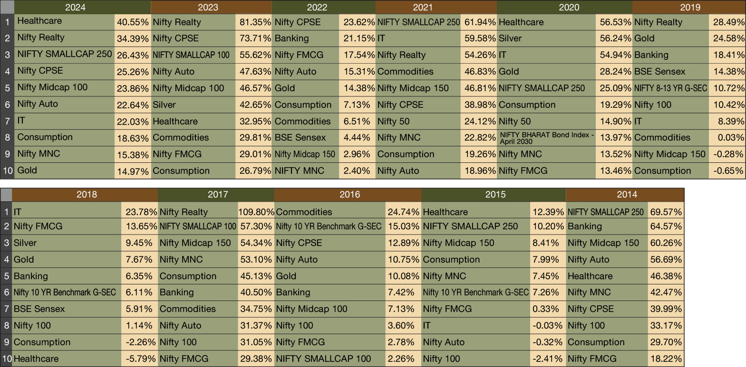
Top 10 Performing Indices/Asset class for each year
We have done the analysis of all indices/Asset class performance of which 10 Unique best performing indices/asset class in the Given Year is shown whose ETFs are also available for investment.

Slide 8
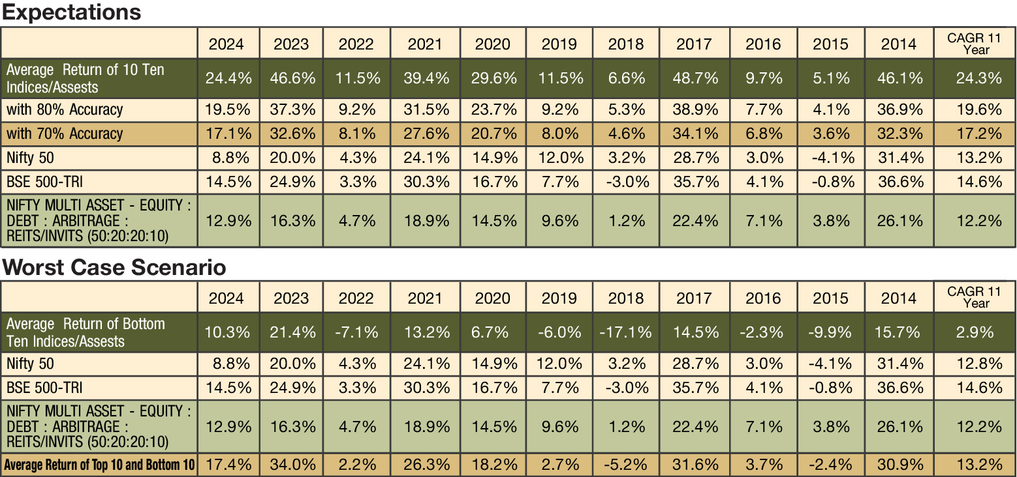
Historical Analysis
It is not possible to predict all top performers for a year and include them in a portfolio. But even with 70% accuracy, we can generate alpha over the benchmarks such as Nifty 50, BSE Sensex and other multi asset indices.
Assuming Tracking Error, Expense on ETF and AMC Charges. Still and alpha creation possible.
Note the above analysis is not the representation of the actual portfolio. Portfolios will be rebalance during the course of time and not annually as shown in the above illustration/Analysis.
Above analysis is just to highlight the possibility of alpha creation through Dynamically Manage Multi Asset Portfolio.

Slide 9
ETF Selection Process
Macro-Level Assessment
Analyze global & domestic macro indicators (GDP growth, inflation, interest rates, liquidity).
Assess sectoral & thematic trends aligned with economic cycle.
Evaluate policy, fiscal & geopolitical developments influencing asset allocation.
Fundamental Evaluation of Underlying
Index
Study earnings growth, valuations, and forward estimates.
Assess sector/constituent weightages and their earnings contribution.
We use Bloomberg estimates to track earnings upgrades.
Technical Analysis
Monitor momentum indicators: RSI to gauge market strength and trend shifts.
MACD trend to identify strength & sustainability of market moves.
Support & resistance analysis to optimize entry/exit levels.
IDEAA PMS follows a Techno-Fundamental approach – combining fundamentals with technical insights for ETF selection.

Slide 10

Types of Asset Classes in ETFs
Equity
Bond
Domestic, international, sector-specific, thematic and index based
Government, corporate, high-yield, international bonds
Commodities
Alternatives
Gold, silver, other commodities
Domestic, international, sector-specific, thematic and index based
Global
Global Stocks & indices ETF

Slide 11

ETF Allocation Approach
30% to 60%
20% to 60%
Broad Equity market Indices ETF of Large, Mid, Small cap ETF and Strategy Base ETF depending upon the valuation and trend.
Sectoral, Thematic, Global Index ETF selected based on the Fundamental Outlook on sector changing (Sector Analyst views
Earnings upgrades in maximum securities part of ETF
Technical momentum turning back or momentum going strong or hitting support
0% to 30%
0% to 50%
Precious commodity like Gold and Silver ETF
Fundamental medium-term Outlook changing
Debt ETF, REITS, INVITS etc.
Medium term changes in Interest rate Outlook and Changes in Economic Outlook.
Technical momentum turning back or momentum going strong or Hitting support

Slide 12

ETF Allocation Approach
Expense Ratio
Underlying Index
ETFs with low expense ratios, as high fees can significantly erode returns over time.
To ensure it aligns with the investment goals and also to check if it is surpassing benchmark returns.
Liquidity
Dividend Yield
Higher average daily trading volume indicates better liquidity, making it easier to buy and sell the ETF without significantly affecting its price.
Higher yields can provide regular income, but ensure the yield is sustainable.
Fund Size and AUM
Larger fund size ensures better stability and lower tracking errors in the ETF.

Slide 13

ETF Allocation Approach
Equity
3 in 1 combination
for securing
your wealth
Debt
Ingenious Dynamic
ETF Asset
Allocation
Alternate (Gold,Silver, REITs, InVITs etc)

Slide 14
Portfolio Allocation & Performance
Data as on 31st August, 2026
Note: Returns above one year are annualized. Returns net of fees and expenses.
Month | Apr-25 | May-25 | Jun-25 | Jul-25 | Aug-25 | Sep-25 | Oct-25 | Nov-25
IDEAA | -0.61% | 1.30% | 2.89% | -1.40% | -1.53% | 2.26% | 3.79% | 1.97%
Nifty Multi Asset | 1.79% | 2.57% | 2.28% | -0.91% | -0.66% | 1.56% | 2.58% | 0.76%
Disclaimer: Past Performance is not necessarily indicative of likely future performance. Performance mentioned above are not verified by SEBI. We have shown the performance as Aggregate performance of all clients on TWRR basis.
Month | Dec-25 | Jan-26 | Feb-26 | Mar-26 | Apr-26 | May-26 | Jun-26 | Jul-26 | Aug-26
IDEAA | 1.20% | 1.13% | 1.27% | -11.35% | 11.75% | 2.24% | -0.65% | 0.69% | 1.0%
Nifty Multi Asset | -0.04% | -1.36% | 0.65% | -6.21% | 5.65% | 0.10% | 1.71% | 1.50% | 0.2%

Slide 15
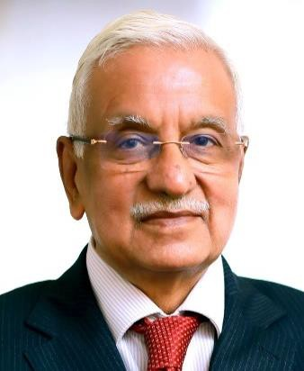
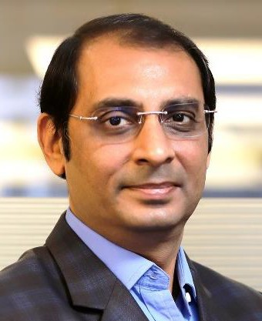
Founder & Promoter (Anand Rathi Group)
Gold medalist Chartered Accountant having more than four decades of rich and varied experience in corporate management, financial & capital markets and corporate & management consultancy.
Served Aditya Birla Group at very senior positions for more than 25 years before starting his own financial services outfit. Shri Rathi was earlier President of BSE for two terms.
Anand Rathi Group derives its strength and vision from legendary leadership of Shri Anand Rathi and charting growth path in his able guidance.
Anand Rathi
Founder & Chairman
Over twenty years broad based experience in the securities market and key driver of the Retail and Institutional Equities business of the group.
Under his leadership, the Group’s Institutional & Retail Business has won great recognition and many accolades. He has played a pivotal role in the Group’s network expansion and pan India growth.
His valuable contribution towards professionalizing the management of the Group has won him immense respect from the corporate world.
Pradeep Gupta Co Founder & Vice Chairman

Slide 16
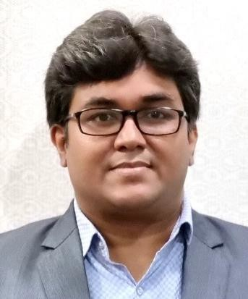
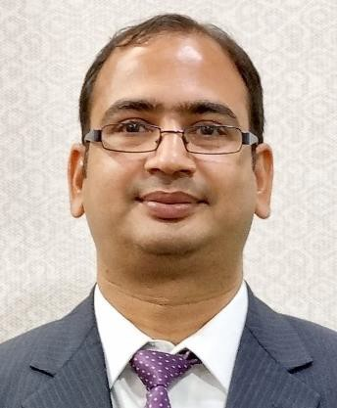
Fund Management Team
More than 21 years of rich experience in Investment advisory, Product Development and Portfolio Management.
Working with Anand Rathi since 2007 across Portfolio Management and Private Client Group Equity Advisory.
Started Career with “Kotak Securities Ltd” in 2005 as an Investment Advisor subsequently got into developing Equity products and running the same.
Qualified MBA (Finance) from Mumbai University and Certified Financial Planner.
Mayur Shah
Fund Manager
More than 22 years of rich experience in Investment advisory, Portfolio Management and research.
Worked in past with Standard Chartered Securities, Religare Securities, Enam Securities.
PGDBM from Mumbai & CS Inter.
Vinod Vaya
Vice President

Slide 17




Features
IDEAA PMS
Minimum investment
Strategy
Allocation
Rs. 50 lakhs.
Multi Asset
8 -15 ETFs, diversified across Equity ETF, Gold & Silver ETF, Debt ETF, International Equity ETF, REITS, INVITs and any other ETF.
Investment Approach
Multi Asset Investment Approach – with minimum 50% in Equity ETFs & Remaining in other asset class ETFs.
Risk - Reward & Tenure
Moderate Risk. Investment tenure 3 year plus
Type of instruments
ETF & Cash & Cash Equivalent
Benchmark
NIFTY MULTI ASSET – EQUITY : DEBT : ARBITRAGE : REITS/INVITS (50:20:20:10)
Fees & Charges
Benefits
Dedicated Web Login for client to monitor portfolio.
A relationship manager to cater to investment needs
Constant monitoring of the portfolio
Audited statement at year end for tax filing purpose.
Support
Back office customer service desk to address client queries
AMC fees Brokerage
: 2.5% p.a (Charged Pro-rata at end of each quarter)
: 0.03% on Equity delivery transaction
Exit Load : 2% - 1st Year, 1% - 2nd Year, NIL after 2nd Year.
Other Charges : GST, Other charges levied by Exchange, Custodial charges (3 bps) levied by custodian and any other statutory charges.

Slide 18












Specific Disclaimer
All Investment are subject to Market Risk.
Please read the risk factors before investing in the same.
Past Performance is not necessarily indicative of likely future performance
Registration Details
Direct On-Boarding
To invest directly into our PMS, please:
Mail: pmsdesk@rathi.com
Contact: 022-62813851, 52
Or click here:
https://www.anandrathipms.com/contact-us.php
PMS registered under : Anand Rathi Advisors Ltd.
PMS Registration Number : INP000000282.
Custodian : Orbis Financial Corporation Ltd.
Product Support
Back Office Support
More Information
Visit Our Website: https://www.anandrathipms.com
Click here for Disclosure Document
Name : Vinod Vaya
Name
: Namita / Mitali
Tel : 022 - 6281 3851 Tel : 022 – 6281 1577 / 3869
Email ID : vinodvaya@rathi.com Email ID : pmsdesk@rathi.com
OFFICIAL ADDRESS: 10th Floor, Express Zone - A Wing, Western Express Highway, Malad (East), Mumbai - 400063, India
BOARD LINE : +91 22 6281 7000

Slide 19



THANK YOU
Disclaimer:-This presentation has been issued by Anand Rathi Advisors Limited (ARAL), which is regulated by SEBI. Neither the information nor any opinion expressed constitutes an offer, or an invitation to make an offer, to buy or sell any securities or any options, futures or other derivatives related to such securities ("related investments"). ARAL and its affiliates may trade for their own accounts as market maker / jobber and/or arbitrageur in any securities of this issuer(s) or in related investments, and may be on the opposite side of public orders. ARAL, its affiliates, directors, officers, and employees may have a long or short position in any securities of this issuer(s) or in related investments. ARAL or its affiliates may from time to time perform investment banking or other services for, or solicit investment banking or other business from, any entity mentioned in this report. This presentation is prepared for private circulation. It does not have regard to the specific investment objectives, financial situation and the particular needs of any specific person who may receive this report. Investors should seek financial advice regarding the appropriateness of investing in any securities or investment strategies discussed or recommended in this report and should understand that statements regarding future prospects may not be realized. Investors should note that income from such securities, if any, may fluctuate and that each security's price or value may rise or fall. Past performance is not necessarily a guide to future performance. Foreign currency rates of exchange may adversely affect the value, price or income of any security or related investment mentioned in this report.

