Slide 1


Investment Approach
August, 2026

Slide 2

Objective
Focus on return optimization by investing in multicap portfolio of companies with good corporate governance, strong emerging business or companies entering into next business upcycle.
India Vision: Global Powerhouse with USD 5 Trillion dollar economy by 2025

Slide 3

Dual Focus Portfolio Strategy
Investing in companies which are likely to benefit from Industrial Revolution, new age business, favorable Policies, and companies that are showing visible sign of turnaround with higher growth in their next business up cycle.

Slide 4
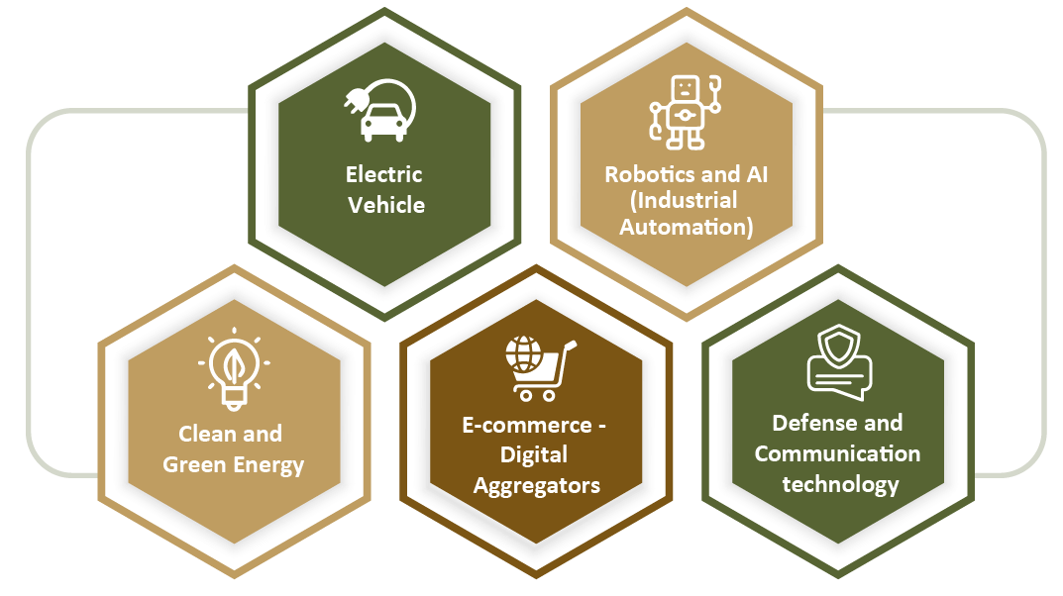
Emerging business of ongoing Industrial Revolution
Note: The above opportunity are given for illustration purpose there are many other emerging business in this ongoing industrial revolution, which could form a part of portfolio.

Slide 5
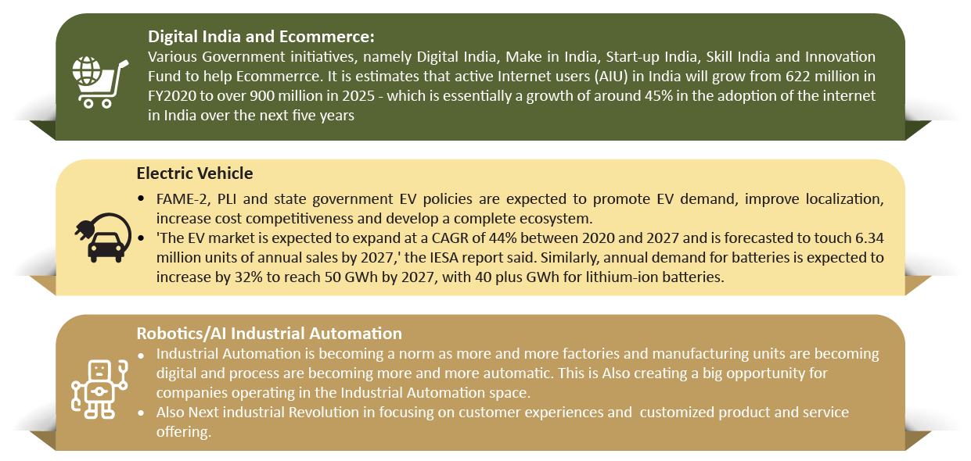
Emerging business of ongoing Industrial Revolution
Note: The above opportunity are given for illustration purpose there are many other emerging business in this ongoing industrial revolution, which could form a part of portfolio.

Slide 6
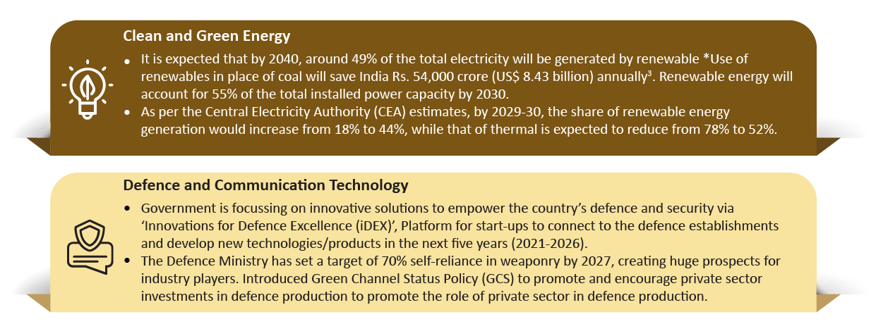
Emerging business of ongoing Industrial Revolution
Note: The above opportunity are given for illustration purpose there are many other emerging business in this ongoing industrial revolution, which could form a part of portfolio.

Slide 7
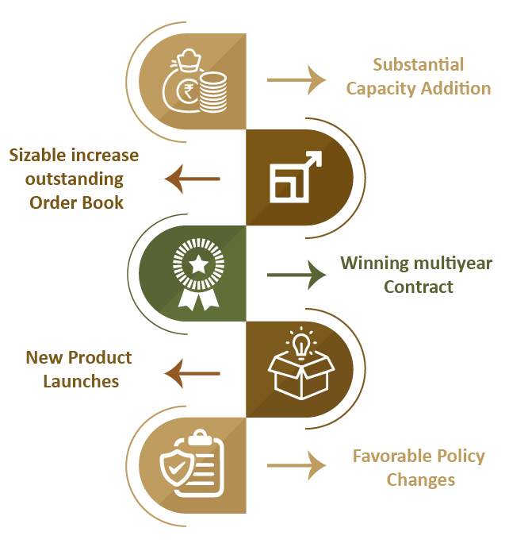
Opportunity - Accelerated Growth from Business Upcycle
  Indian economy has found its place among the key global players in many of the sectors.
  India increasing its share and becoming a part of the global supply chain and also a reliable partner.
  Government focus on building capabilities, scale and good manufacturing practices.
  PLI, Export incentive and Atmanirbhar Bharat Initiative very well supportive to strengthen India’s private players/ Enterpreneurs to scale up their business.
  With overall economic growth both at macro and micro level and favorable policy many sectors enters into their next business upcycle

Slide 8
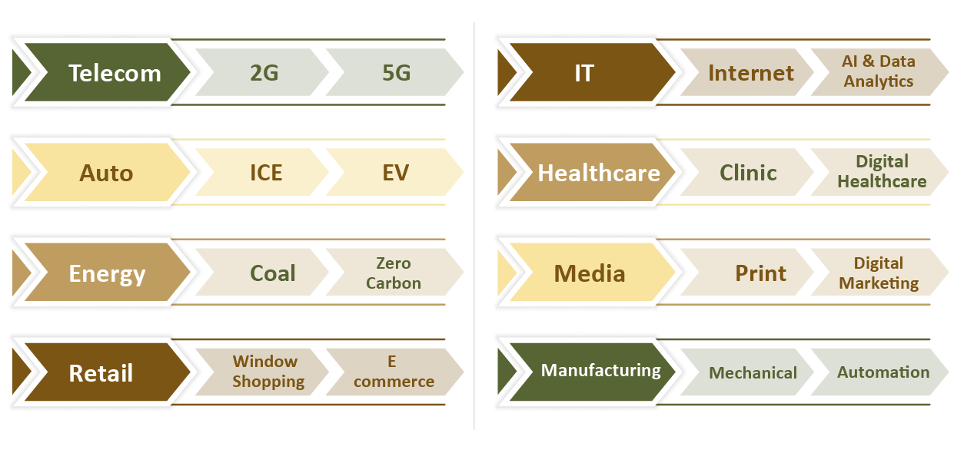
Opportunities at every level of emerging business
The key to success is to adapt to the changing business dynamics.

Slide 9
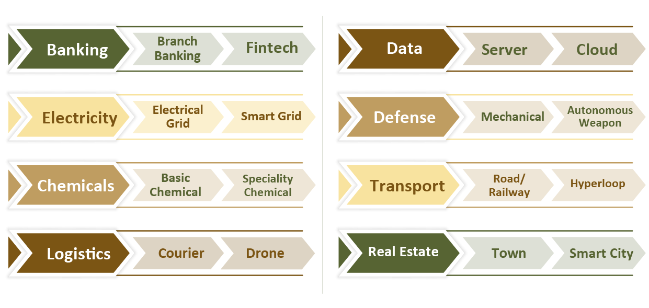
Opportunities at every level of emerging business
The key to success is to adapt to the changing business dynamics.

Slide 10
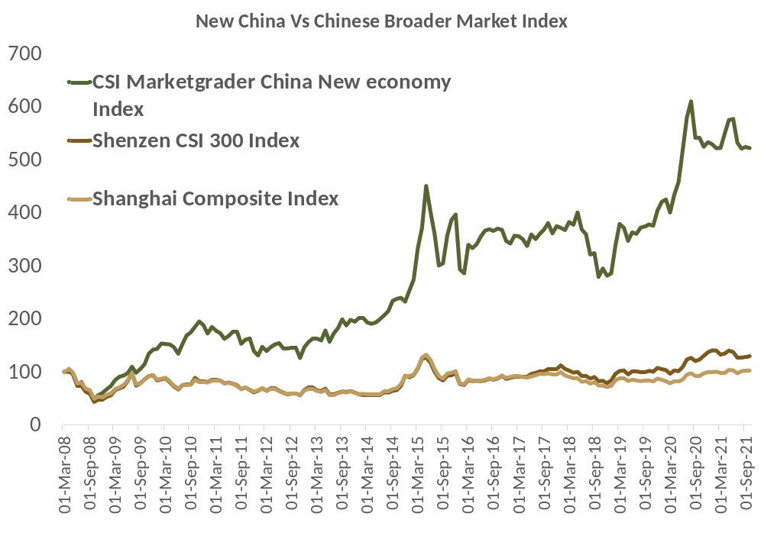
Potential Opportunity
We can see from the graph the stocks in New economy China has outperformed the broader markets in China.
Indian economy too is witnessing the similar trend with new economy sectors and companies likely to showcase strong growth relative to broader market in coming years.
The MarketGrader China New Economy Index seeks to follow the most fundamentally sound companies with the best growth prospects in the Consumer Staples, Consumer Discretionary, Technology, and Health Care sectors that are domiciled and listed in Mainland China.
Source: Bloomberg/ Market Grader

Slide 11
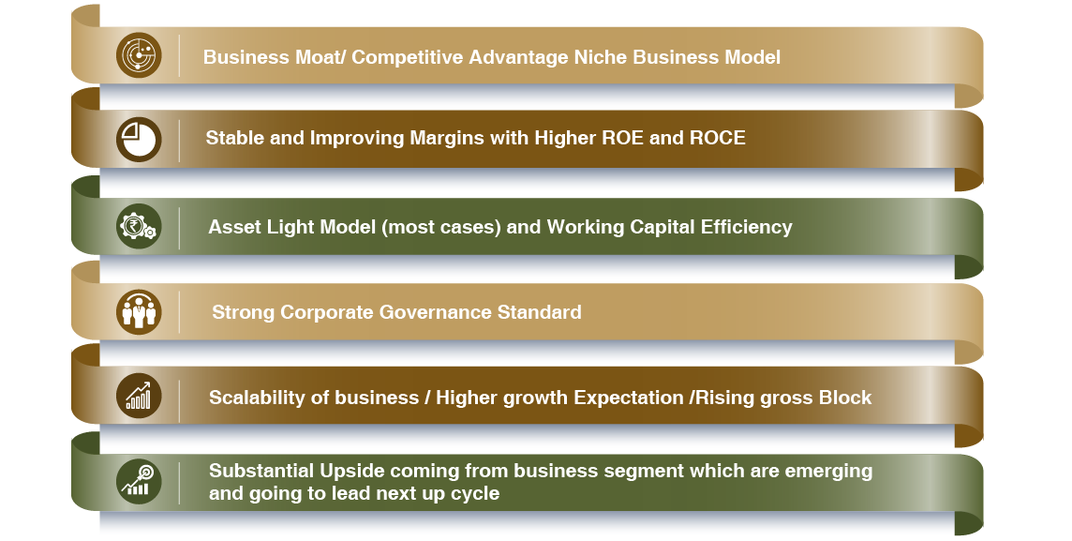
Stock Selection Process

Slide 12
4P Strategy – Stock Selection
4P
Past Analysis
Business Moat /Market Share
Operating efficiency
Working Capital Management
Balance sheet growth
ROE And ROCE growth etc
Present Analysis
Current vs Historical
Valuation, Margins, leverage, Asset Turnover
Capacity and utilisation
Capex and Cashflow
Pedigree
Management Experience and Qualification
Corporate Governance Practices
Shareholding patterns
Potential
Sector Outook Favourable Macro
Sufficient capacity
Outstanding Order Book,
Multi year Contract, Client Addition,
Product Pipeline etc
Companies to undergo 4 P Analysis to make it to the Universe

Slide 13
Portfolio Strategy
Decennium Opportunity
Multi-cap Style of investment, Fund manager may change the allocation according to market condition. Minimum market Cap of 1000 cr
Portfolio Positioning Moderate to Aggressive Risk & Reward
Allocation
High
Max Sector Allocation 20%
Max Single Stock Allocation 10%
Large Cap
Mid Cap
Small Cap
Decennium Opportunity
Reward
Low
Risk
High

Slide 14
Re-VIEW Strategy
V
Valuation Check
A constant check is kept on the valuation of the companies so that any stock whose valuation becomes relatively high, due to any reasons like sentiments or increase in liquidity, is exited before any price correction comes to the stock. We then shift the money to a new stock with a reasonable valuation.
I
Impact of Events
A stock price can be highly affected by an event or series of events, recent examples: COVID crisis, Russia-Ukraine War, Increase in Crude Price, Interest Rates Hike etc. Our team actively tracks these events and makes timely modifications as per the situation’s needs to minimize risks & optimize returns.
E
Earnings Visibility Changes
Our fundamental research team scrutinizes the quarterly results of the companies to understand the current & future estimated growth. If we are not satisfied with 2 or 3 quarterly results of the company & don’t see growth, we take an exit to move to another stock.
W
Weightage Check of the Holdings
Every stock & sector has been capped to a certain percentage of the total allocation to limit downside due to any uncertainties and also diversify the portfolio. If any stock or sector reaches near to the decided percent of allocation, we book profits and reduce the weightage and invest into any other stock.

Slide 15
Portfolio Synopsis
Sr No | Top 10 Holdings | % Holdings
1 | Craftsman Automation Limited | 8.23%
2 | Syrma SGS Technology Limited | 7.70%
3 | Polycab India Limited | 7.48%
4 | Ethos Limited | 6.98%
5 | Venus Pipes and Tubes Limited | 6.91%
6 | ICICI Prudential Asset Management Company Ltd | 6.86%
7 | Bharat Electronics Ltd | 6.64%
8 | Caplin Point Laboratories Limited | 6.29%
9 | Global Health Limited | 6.01%
10 | Tata Capital Limited | 5.86%
Avg Market Cap (cr)
Large Cap | 2,14,545
Midcap | 56,236
Small Cap | 17,415
Overall Portfolio | 81,732
The current model client portfolio comprise of 15 stocks. Portfolio is well diversified across market capitalization and sector. Most of the stocks are given more or less equal and sizable weightage in portfolio.
Data as on 31st August, 2026

Slide 16
Portfolio Synopsis
Disclaimer: Past Performance is not necessarily indicative of likely future performance. Performance mentioned above are not verified by SEBI. We have shown the performance as Aggregate performance of all clients on TWRR basis.
Note: - Returns above one year are annualized. Returns are net of all fees and expenses.

Slide 17
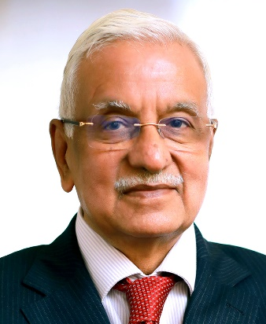
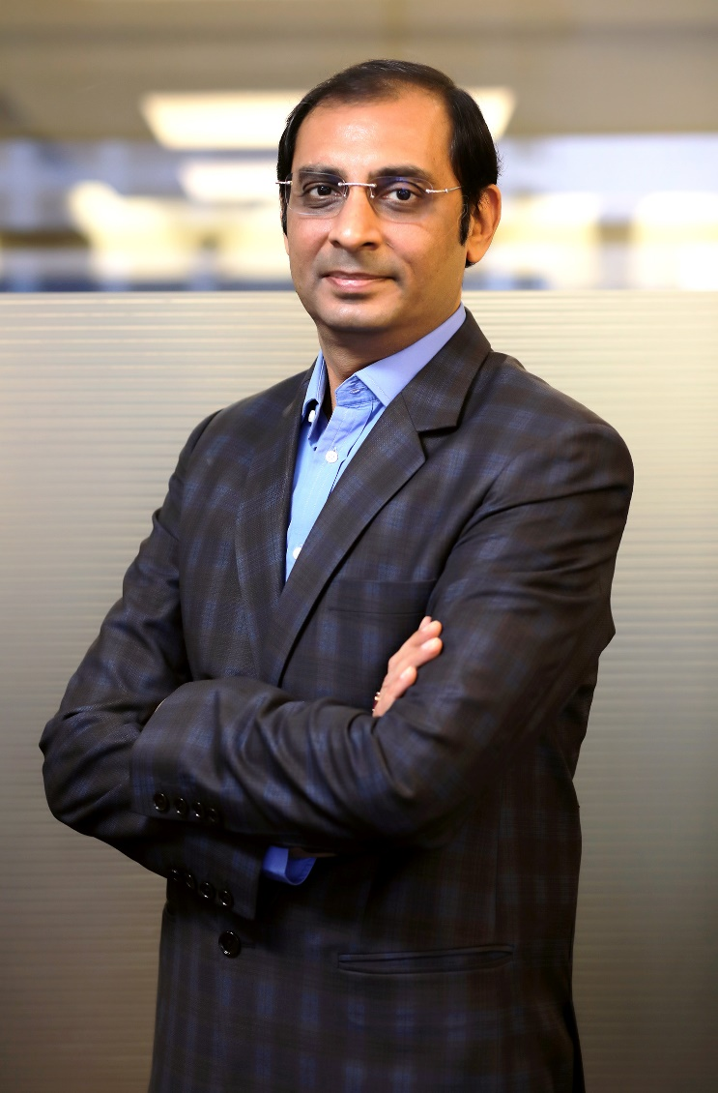
Founder & Promoter (Anand Rathi Group)
Gold medalist Chartered Accountant having more than four decades of rich and varied experience in corporate management, financial & capital markets and corporate & management consultancy.
Served Aditya Birla Group at very senior positions for more than 25 years before starting his own financial services outfit. Shri Rathi was earlier President of BSE for two terms.
Anand Rathi Group derives its strength and vision from legendary leadership of Shri Anand Rathi and charting growth path in his able guidance.
Anand Rathi
Founder & Chairman
Over twenty years broad based experience in the securities market and key driver of the Retail and Institutional Equities business of the group.
Under his leadership, the Group’s Institutional & Retail Business has won great recognition and many accolades. He has played a pivotal role in the Group’s network expansion and pan India growth.
His valuable contribution towards professionalizing the management of the Group has won him immense respect from the corporate world.
Pradeep Gupta
Co Founder &
Vice Chairman

Slide 18
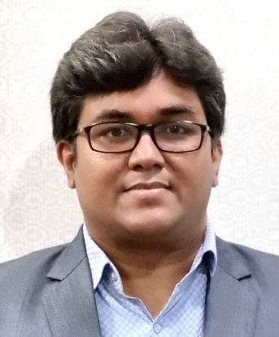
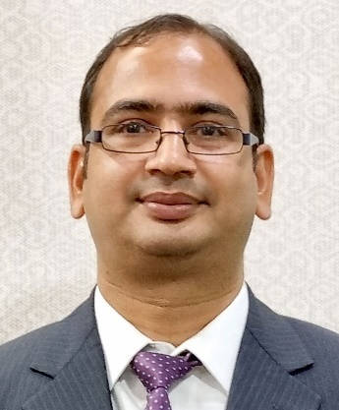
Fund Management Team
More than 21 years of rich experience in Investment advisory, Product Development and Portfolio Management.
Working with Anand Rathi since 2007 across Portfolio Management and Private Client Group Equity Advisory.
Started Career with “Kotak Securities Ltd” in 2005 as an Investment Advisor subsequently got into developing Equity products and running the same.
Qualified MBA (Finance) from Mumbai University and Certified Financial Planner.
Mayur Shah
Fund Manager
More than 22 years of rich experience in Investment advisory, Portfolio Management and research.
Worked in past with Standard Chartered Securities, Religare Securities, Enam Securities.
PGDBM from Mumbai.
Vinod Vaya
Vice President

Slide 19
Features
Decennium Opportunity Portfolio
Minimum Investment
Allocation
Investment Approach
Risk - Reward & Tenure
Type of Instruments
Benchmark
Rs. 50 lakhs
15-20 STOCKS, diversified across sectors.
Diversified portfolio of emerging business in India and Companies entering in next business up cycle.
Aggressive risk reward. Investment tenure preferably 3 years+
Equity & Equity Related Instruments, Fixed Income Instruments, Cash & Cash Equivalent
BSE 500 TRI
Fees & Charges
Benefits:
Dedicated Web Login for client to monitor portfolio.
A relationship manager to cater to investment needs
Constant monitoring of the portfolio
Audited statement at year end for tax filing purpose.
Support:
Back-office customer service desk to address client queries
AMC fees : 2.5% p.a (Charged Pro-rata at end of each quarter)
Brokerage : 0.10% on Equity delivery transaction
Exit Load : 2% - 1st Year, 1% - 2nd Year, NIL from 3rd Year.
Other Charges : GST, Other charges levied by Exchange, Custodial charges (3 bps) levied by custodian and any other statutory charges.

Slide 20
Specific Disclaimer
Registration Details
All Investments are subject to Market Risk.
Please read the risk factors before investing in the same.
Past Performance is not necessarily indicative of likely future performance.
PMS registered under : Anand Rathi Advisors Ltd.
PMS Registration Number : INP000000282.
Custodian : Orbis Financial Corporation Ltd.
Product Support
Back Office Support
More Information
Name : Vinod Vaya
Tel : 022 – 6281 3851
Email ID : vinodvaya@rathi.com
Name : Manan / Sourabh
Tel : 022 – 6281 1556
Email ID : pmsdesk@rathi.com
Visit our website : https://www.anandrathipms.com
Click here for : Disclosure Document
Contact Details
Direct On-Boarding
OFFICIAL ADDRESS : 10th Floor, Express Zone - A Wing, Western Express Highway, Goregaon (East), Mumbai - 400063, India
BOARD LINE : +91 22 6281 7000
To invest directly into our PMS, please:
Mail : pmsdesk@rathi.com
Contact : 022-62813851 / 52
Or click here : https://www.anandrathipms.com/contact-us.php

Slide 21



THANK YOU
Disclaimer:-This presentation has been issued by Anand Rathi Advisors Limited (ARAL), which is regulated by SEBI. Neither the information nor any opinion expressed constitutes an offer, or an invitation to make an offer, to buy or sell any securities or any options, futures or other derivatives related to such securities ("related investments"). ARAL and its affiliates may trade for their own accounts as market maker / jobber and/or arbitrageur in any securities of this issuer(s) or in related investments, and may be on the opposite side of public orders. ARAL, its affiliates, directors, officers, and employees may have a long or short position in any securities of this issuer(s) or in related investments. ARAL or its affiliates may from time to time perform investment banking or other services for, or solicit investment banking or other business from, any entity mentioned in this report. This presentation is prepared for private circulation. It does not have regard to the specific investment objectives, financial situation and the particular needs of any specific person who may receive this report. Investors should seek financial advice regarding the appropriateness of investing in any securities or investment strategies discussed or recommended in this report and should understand that statements regarding future prospects may not be realized. Investors should note that income from such securities, if any, may fluctuate and that each security's price or value may rise or fall. Past performance is not necessarily a guide to future performance. Foreign currency rates of exchange may adversely affect the value, price or income of any security or related investment mentioned in this report.

